Slide 1
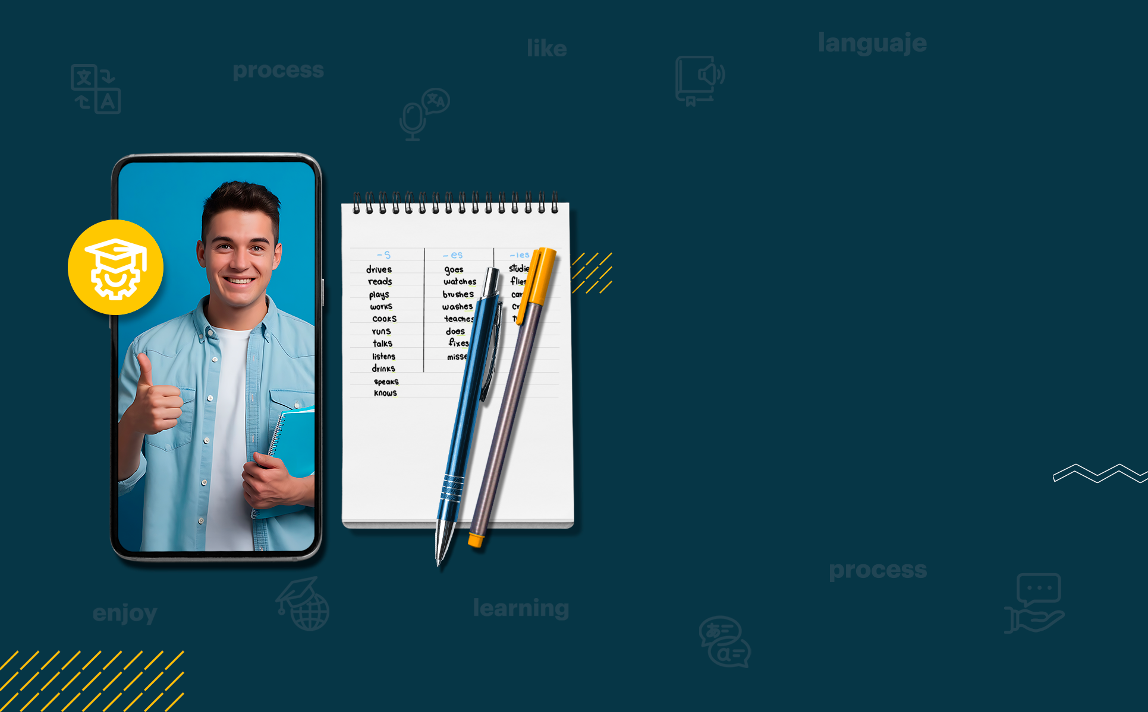

ENGLISH LEVEL B1 - II
Lesson 02
GOING TO THE RESTAURANT
Notes:
Teacher’s Notes:
Explain the lesson goal: learning words and sentences related to hospitals.
Ask students: Have you ever been to a hospital? Why?

Slide 2

01
Talking in a restaurant
ENGLISH LEVEL B1 - II

Slide 3

GOING TO THE RESTAURANT
RESTAURANT CONTEXT Look at the situations and answer the questions:
You are in a fancy restaurant but the menu is in a language you don’t understand. What do you do?
1
You are in a fast-food restaurant and they get your order wrong. What would you do?
2
You are with a friend at a café, and you don’t know what to order. How do you ask for recommendations?
3

Slide 4
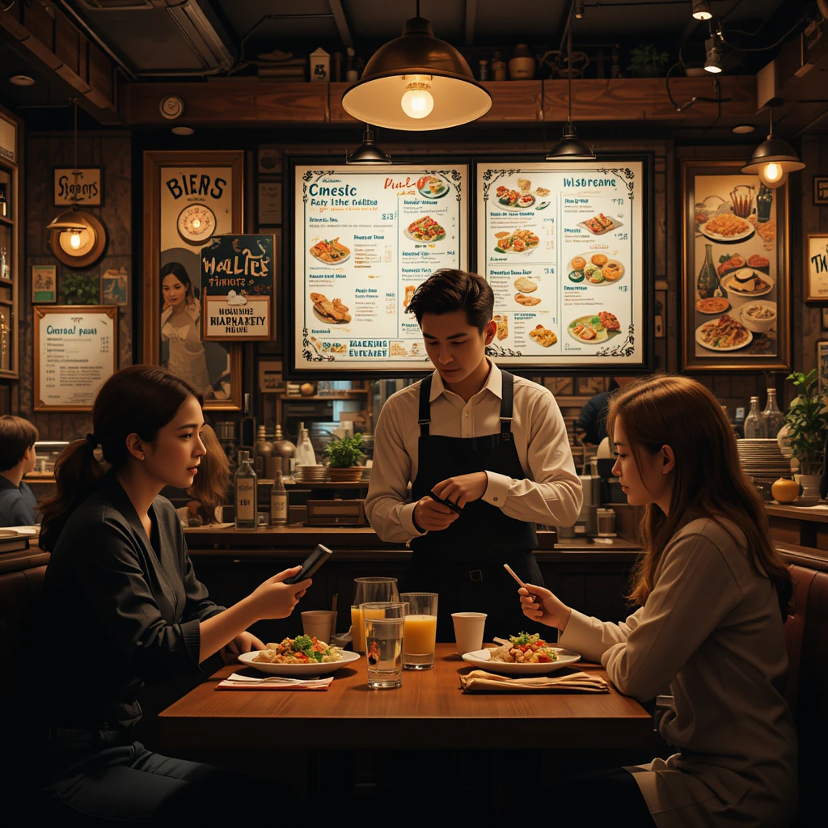
GOING TO THE RESTAURANT
Look at the picture of a restaurant scene and answer the questions.
What do you see in the picture?
What do you think the people in the picture are talking about?
What type of restaurant do you think this is and what would you order?
Have you ever been to a place like this? How was your experience?

Slide 5

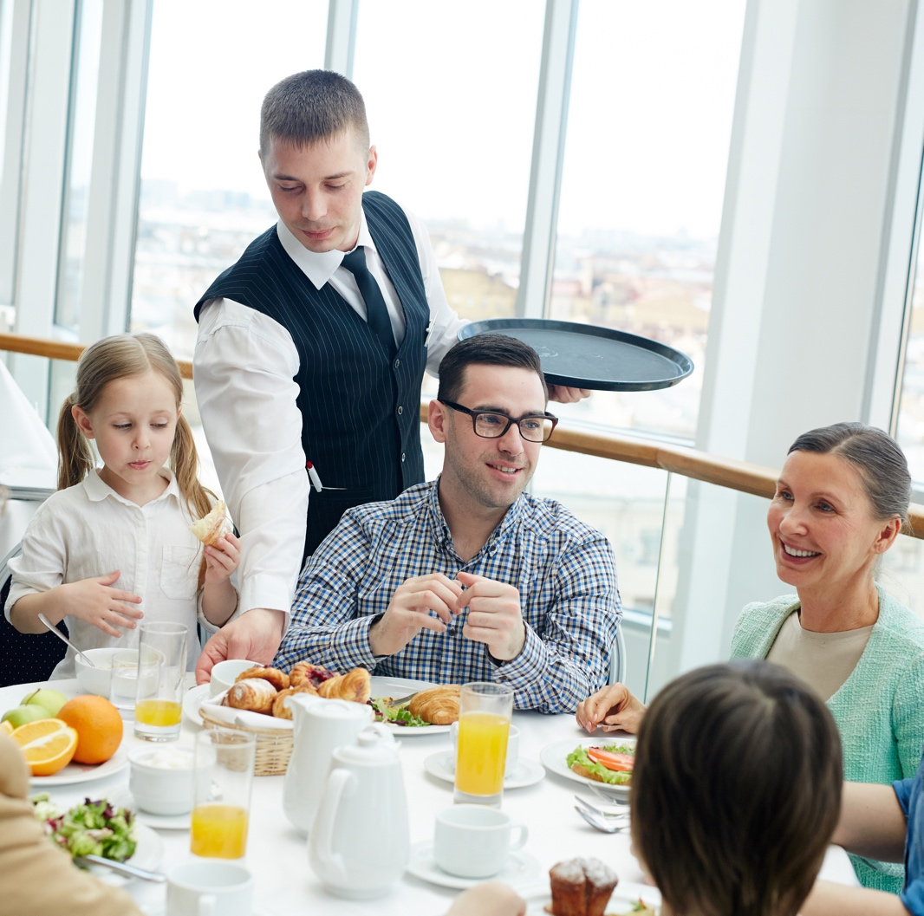
GOING TO THE RESTAURANT
Listen to the conversation about going to the restaurant and answer the questions below:
What drinks did the customers order?
What meal did the waiter recommend for the children?
What issue did the customers have with their order?
How did the customers ask for the bill, and how did they choose to pay?
INSERTAR DIÁLOGO ALTISSIA

Slide 6
GOING TO THE RESTAURANT
DAYS OF THE WEEK
Vocabulary:
Activity:
English Word/Phrase | Meaning | Example Sentence
Menu | A list of food items in a restaurant | "Can I see the menu, please?"
Order | To request food at a restaurant | "I'd like to order a burger."
Bill/Check | The receipt you pay at a restaurant | "Could we get the bill, please?"
Tip | Extra money given to the waiter for service | "Do we need to leave a tip?"
Complete the text with the correct word: waiter, menu, bill, tip.
A: Excuse me, can I have the ____?
B: Sure! Here it is.
A: I'd like to order a pasta.
B: Great choice! I'll tell the ____.
A: Thank you. (After eating)
A: Can I have the ____ now?
B: Yes, here you go.
A: Should we leave a ____?

Slide 7
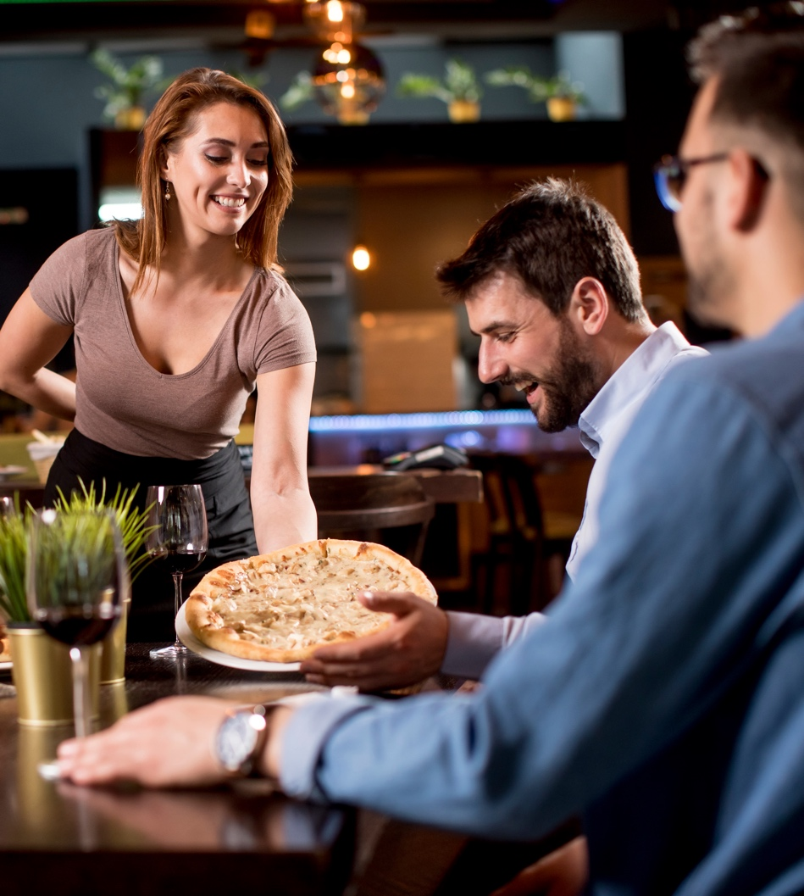
GOING TO THE RESTAURANT
SENTENCE ORDERING
Put the words in the correct order to form questions:
see / the / menu / Can / I / ?
order / like / to / I'd / a pizza / .
get / check / the / Can / we / ?
please / glass / of / water / Can / I / have / a / ?

Slide 8
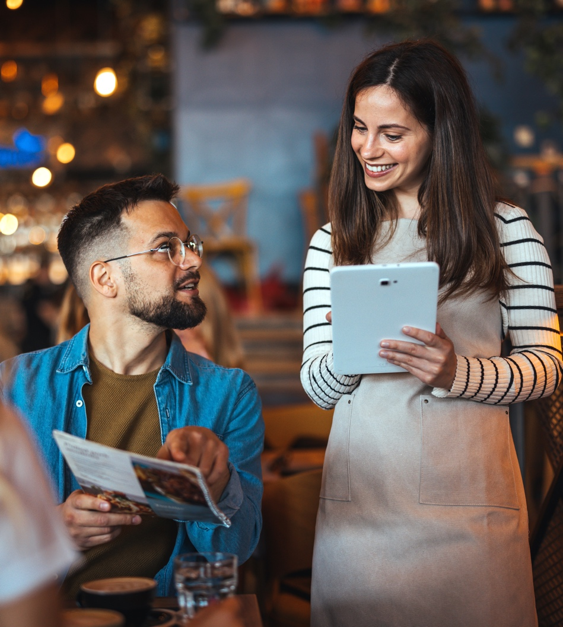
GOING TO THE RESTAURANT
Role play activity
Work in pairs.
One student is a waiter/waitress, the other is the customer.
Create a dialogue in a restaurant using the vocabulary provided.
Switch roles after each round.
Example:
Waiter: Good evening! Welcome to the Restaurant. Would you like to see the menu?
Customer: Yes, please.
Waiter: What would you like to order?
Customer: I’d like chicken.
Waiter: Would you like something to drink?
Customer: Yes, I’ll have water.
Waiter: Your order will be ready soon.

Slide 9
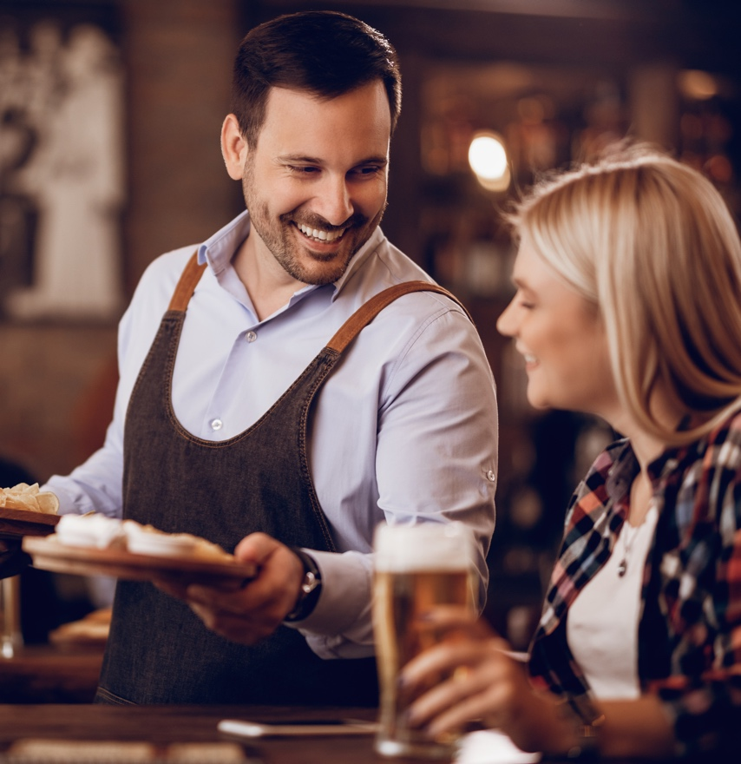

GOING TO THE RESTAURANT
CLASS DISCUSSION: REFLECT AND APPLY
What was easy/difficult about ordering food in English?
Share your experiences of ordering food at a restaurant in English.
Answer these quick questions:
What expressions do you remember from today’s lesson?
How do you ask for the check?
What polite phrases can you use in a restaurant?

